Slide 1
Competencias previas
Programación Orientada a Objetos
Ing. Arturo Hinojosa Ramírez

Slide 2


Aplica algoritmos y lenguajes de programación
para diseñar e implementar soluciones a
problemáticas del entorno.

Slide 3
Diseño Algorítmico
Pseudocódigo
Diagramas de flujo
Introducción a la Programación
Conceptos básicos.
Control de Flujo
Estructuras selectivas: simple, doble y
Características del lenguaje de programación.
Estructura básica de un programa.
Elementos del lenguaje: tipos de datos, literales, constantes, variables, identificadores parámetros, operadores y salida de datos.
múltiple.
Estructuras iterativas: repetir mientras, hasta, desde.

Slide 4
Organización de datos
Arreglos
Modularidad
Unidimensionales
Multidimensionales
Funciones

Slide 5
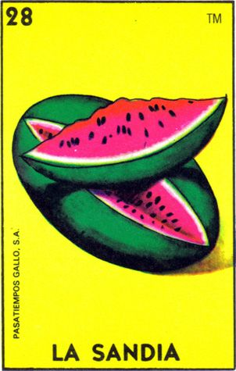

Slide 6
One hot summer day Pete and his friend Billy decided to buy a watermelon. They chose the biggest and the ripest one, in their opinion. After that the watermelon was weighed, and the scales showed w kilos. They rushed home, dying of thirst, and decided to divide the berry, however they faced a hard problem.
Pete and Billy are great fans of even numbers, that's why they want to divide the watermelon in such a way that each of the two parts weighs even number of kilos, at the same time it is not obligatory that the parts are equal. The boys are extremely tired and want to start their meal as soon as possible, that's why you should help them and find out, if they can divide the watermelon in the way they want. For sure, each of them should get a part of positive weight.

Slide 7

Input
The first (and the only) input line contains integer number w (1 ≤ w ≤ 100) — the weight of the watermelon bought by the boys.
Output
Print YES, if the boys can divide the watermelon into two parts, each of them weighing even number of kilos; and NO in the opposite case
Input
8
Output
YES
Note
For example, the boys can divide the watermelon into two parts of 2 and 6 kilos respectively (another variant — two parts of 4 and 4 kilos)

Slide 8
start
r , w integer
w
r = w % 2
r = 0
True
YES
end
False
NO

Slide 9
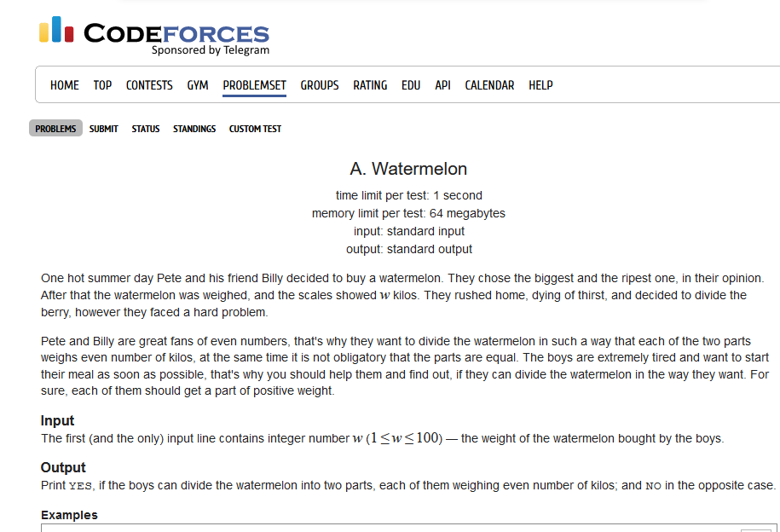
http://codeforces.com/problemset/problem/4/a

Slide 10

w = 2
bill = 1
pete = 1
r = 2 % 2 = 0

Slide 11
start
r , w integer
w = 2
w
True
NO
r = w % 2
False
YES
r = 0
True
False
end
NO

Slide 12
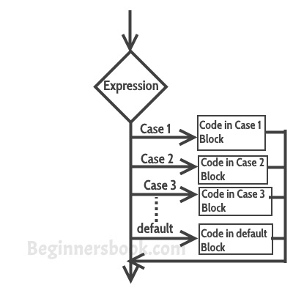
Switch Case statement
Switch case statement is used when we have number of options (or choices) and we may need to perform a different task for each choice.

Slide 13
switch (variable or an integer expression)
{
case constant:
//Java code
;
case constant:
//Java code
;
default:
//Java code
;
}

Slide 14
Break statement in Switch Case
Break statements are used when you want your program-flow to come out of the switch body. Whenever a break statement is encountered in the switch body, the execution flow would directly come out of the switch, ignoring rest of the cases

Slide 15
int i=2;
switch(i)
{
case 1:
System.out.println("Case1 ");
break;
case 2:
System.out.println("Case2 ");
break;
case 3:
System.out.println("Case3 ");
break;
case 4:
System.out.println("Case4 ");
break;
default:
System.out.println("Default ");
}

Slide 16
Scanner scanner=new Scanner(System.in);
System.out.println("Enter a character : ");
char ch=scanner.next().charAt(0);
switch(ch)
{
case 'a' :
case 'e' :
case 'i' :
case 'o' :
case 'u’ : System.out.println(“Vocales”);
}

Slide 17
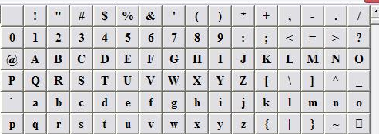
vowels consonants symbols
Given a character identify if it is a vowel, consonant, number or another symbol

Slide 18
Input
Output
A
9
F
$
a
vowels
number
consonants
Symbols
vowels

Slide 19
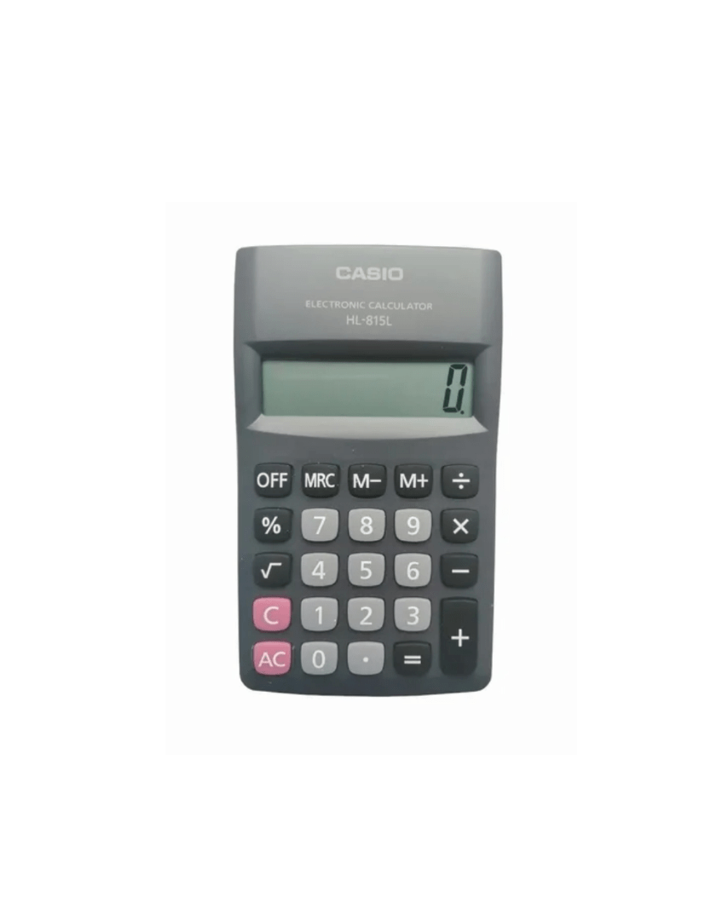
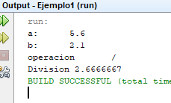
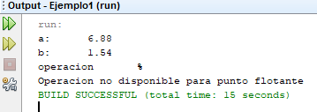
Allows the input of floating values ​​to your calculator, consider that the module is only for integer values

